Slide 1

Subscribe to DeepL Pro to edit this document.
Visit www.DeepL.com/pro for more information.

Slide 2
Presentation of the ‘Audible Maths’ software package
Dr Szilvia Szakácsné Nagy
SZIE GAEK
Institute of Applied Natural Sciences
Lecturer
“The Liveable City and its Surroundings” Symposium – Békéscsaba, 22 November 2012

Slide 3
A brief summary of the content
Basic mathematical competences to be developed
Perception based on the integration of multiple senses
Presentation of teaching aids

Slide 4
Basic mathematical skills to be developed

Slide 5
Auditory maths as a teaching tool
Target group: older nursery children, Year 1 pupils
Objective: to present mathematical structures through sound
interpreting operations through hands-on activities and sound patterns that evoke them
Developing the ability to recognise and organise relationships by observing changes, periodicity, rhythm, growth and decline

Slide 6
Key areas for development
Perception
Tactile-kinesthetic
Auditory
Visual
Memory functions
Thinking
Motor symptoms

Slide 7
Basic mathematical skills
Recognition: identifying immediate and previous experiences
Selection: separating a subset from an existing set based on a given or chosen criterion
Grouping: grouping according to a single criterion
Sequencing: arranging objects in a sequence according to a specific rule
Comparison: identifying the different and common characteristics of the things being compared
Rule-making: verbal formulation of the insight

Slide 8
Perception based on the integration of multiple senses

Slide 9

The principle of perceptual (sensory) diversity or the principle of multiple concretisation
(Dienes 1973)
It is advisable to present conceptual structures in a variety of perceptual forms:
Faster recognition of individual differences
Gaining a wealth of experience
Each model highlights different aspects of the concept
Notes:
It is advisable to present conceptual structures to children in as many equivalent forms as possible, yet in ways that appear different to the eye, so that individual differences can be better accommodated in the development of these concepts, and so that children can grasp the abstract mathematical content of each concept as fully as possible.

Slide 10
The types of spontaneous image formation are as follows:
Proximity
We perceive shapes that are close to one another in space or time as a single unit. (In the figure, we do not see six vertical lines, but three pairs of lines.)
Similarity
We organise similar elements within a pattern into groups. (Instead of eight dots, we see two pairs of black dots and two pairs of white dots.)
Direction
We perceive elements that are arranged along a line as belonging together.
Pattern formation
We tend to transfer the organisation we perceive in one pattern to the next, similar instance. Moving from left to right in the figure, we perceive the dots in the figure on the right as being arranged in pairs too, even though their distances are equal.
“Background”
When presented with two similar figures, we feel that the second has emerged from the first; we perceive elements that change their positions in the same way as belonging together.
Flawlessness
If a shape resembles a regular form, we often do not even notice that it is not perfect, for example, that its outline is not continuous.

Slide 11
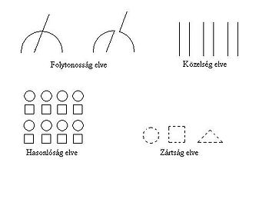
Perceptual grouping

Slide 12
Auditory chain – mathematical structures (1)
The functioning of the auditory system is a necessary but not sufficient condition for the auditory experience
The basic unit of auditory perception: the auditory chain
Organisations of auditory information:
Sequential (in close succession)
Spectral (multiple auditory chains simultaneously)
Gestalt principles also apply to the grouping of auditory information

Slide 13
Auditory chain – mathematical structures (2)
The musical pitch scale allows musical notes to be arranged in order (approx. 20–4000 Hz)
In music, intervals form a regular system based on the octave (8 intervals)
In the perception of musical pitch, it is not the exact pitch of the notes but the intervals between them that are important

Slide 14
Auditory chain – mathematical structures (3)
Rhythm is the regular temporal organisation of certain events
The perception of rhythm is based on the processing of time intervals between events and their periodic repetition
We are easily able to synchronise our movements with a sequence of sounds that has a regular rhythm (we try to plan the exact timing of the movement in advance)

Slide 15
Presentation of teaching aids

Slide 16
Applications of the ‘Audible Maths’ software package
Preparing a number line
Forming a sequence
The number as a quantity
Numbers as units of measurement
Introduction to negative numbers
Software availability

Slide 17
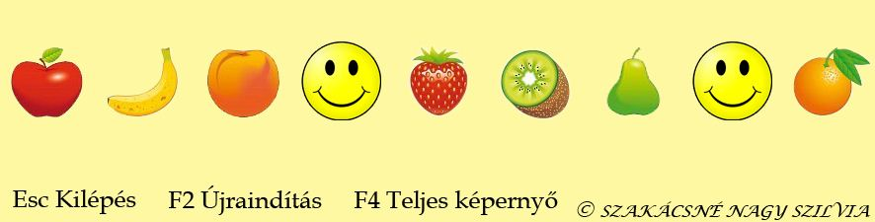
Preparation of a number line

Slide 18
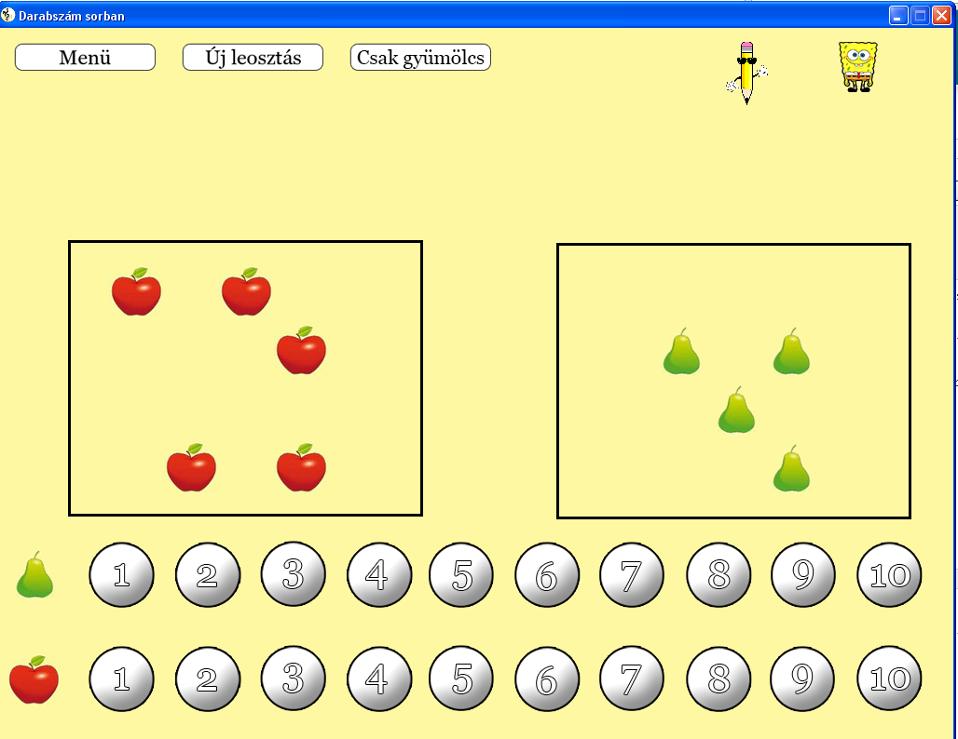
The number as a quantity
Notes:
Convex increasing = accelerating
Concave increasing = decelerating

Slide 19
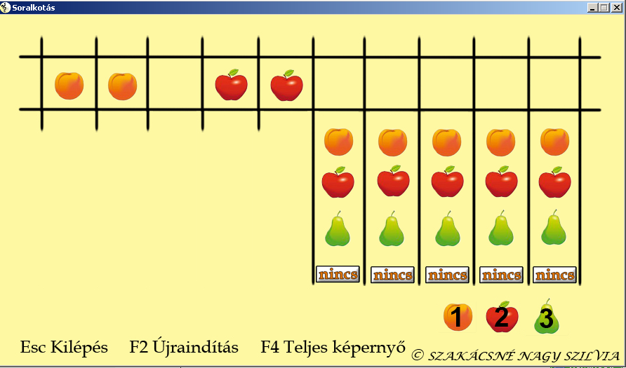
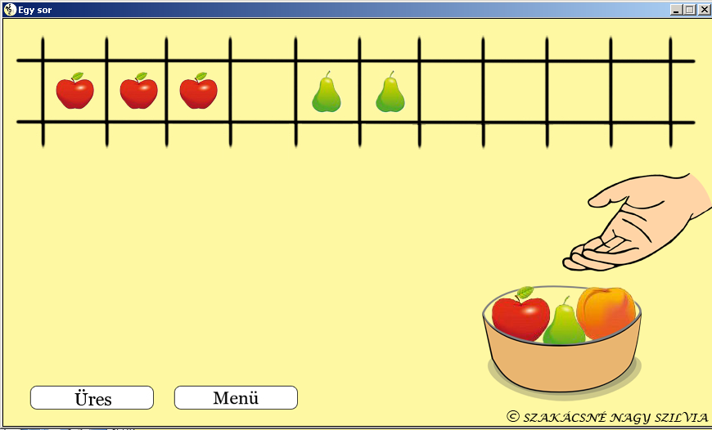
The sequence
Notes:
Convex increasing = accelerating
Concave increasing = decelerating

Slide 20
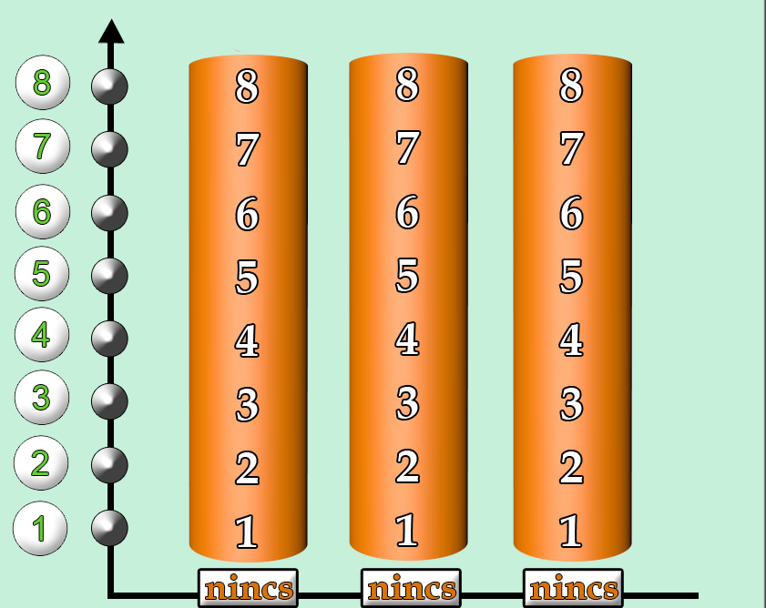
The number as a unit of measurement
Notes:
Convex increasing = accelerating
Concave increasing = decelerating

Slide 21
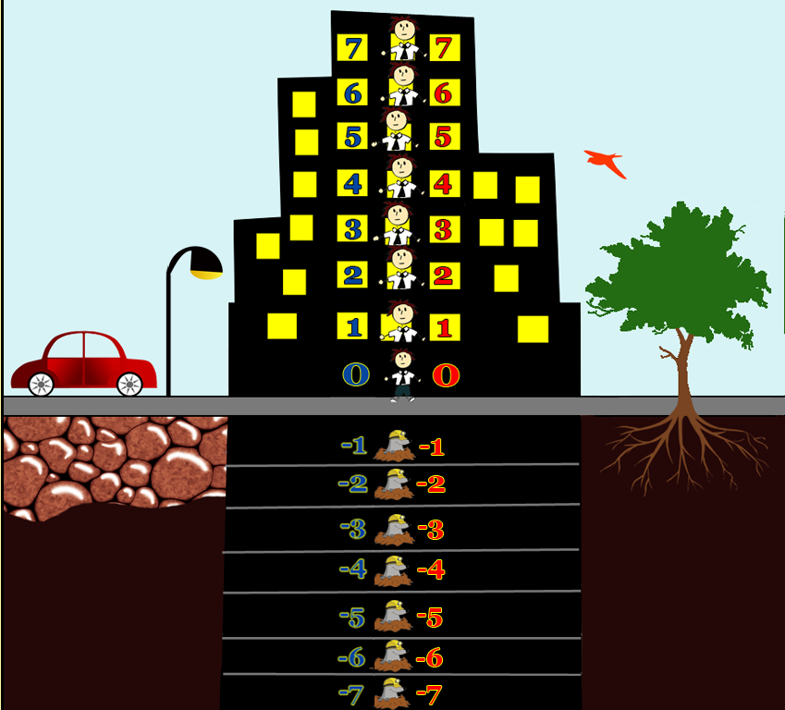
Preparing negative numbers
Notes:
Convex increasing = accelerating
Concave increasing = decelerating

Slide 22
Audio-visual aids in mathematics teaching
“Audible Maths” website http://gfk.tsf.hu/hallhato-matematika/
Contact details:
szakacsne.nagy.szilvia@gk.szie.hu

Slide 23
References
Csaba Pléh (1998). An Introduction to the Philosophy of Mind. Typotex Publishing, Budapest.
Ulric Neisser (1984). Cognition and Reality. Gondolat Publishing House, Budapest.
Gabriella Dohány (2010). Possibilities for Interpreting Musical Literacy. Magyar Pedagógia, Vol. 110, No. 3, pp. 185–210.
Edited by Valéria Csépe, Miklós Győri and Anett Ragó (2007). General Psychology 1 – Perception and Attention. Osiris Publishing, Budapest.
András Ambrus (2003). Classification of tasks based on their function in the educational process. http://xml.inf.elte.hu/~mathdid/
József Peller (2003). On the process of acquiring mathematical knowledge. Eötvös Publishing House – Budapest.
Edited by Ferenc Pálhegyi (1980). Cognitive functions of the visually impaired. Tankönyv Publishing House, Budapest.
R. Skemp: The Psychology of Mathematical Learning, Budapest, 1975.
http://www.viewplus.eu
Éva Vásárhelyi (2003). Concept Formation and Representations. http://xml.inf.elte.hu/~mathdid/

